Slide 1
Unit 106 Understand and demonstrate fundamental electrical installation operations
Outcome 7 Be able to carry out basic electrical practical applications
Bob Eyre

Slide 2
Objectives
7.1 carry out the following tasks safely:
interpret typical drawings and specifications related to basic practical applications
measure accurately and record the requirements for the installation
correctly wire a 3 pin plug
assemble a simple one-way electrical lighting circuit with battery supply
insert a simple switch mechanism into the completed wiring circuit
7.2 safely test for continuity completed wiring circuit
7.3 demonstrate that the work area is left in a safe condition after completion of the task:
area is left clean and tidy
return tools and equipment
return excess materials
dispose of any waste materials.

Slide 3
Theory Part of Your Practical Assessment
This outcome relates to the practical part of your practical assessment which takes place in the last few weeks of this module.
In it you will need to
demonstrate your understanding of theory you have been taught throughout the module
demonstrate your practical skills by carrying out a couple of electrical task.
Photographic evidence will be taken before you disassemble your work and tidy up.

Slide 4
Interpret Drawings
In order to be able to carry out the tasks you should be able to interpret drawings and diagrams that are often used to instruct how things should be installed.
Commonly used examples are
  Circuit Diagram
  Wiring Diagrams

Slide 5
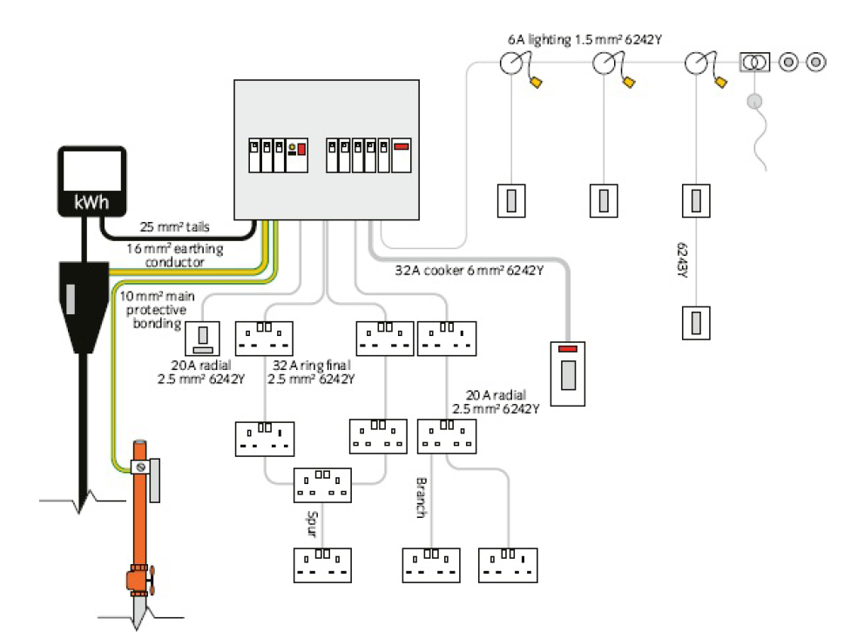
Interpret Drawings - Wiring Diagrams
Wiring diagrams are generally provided to show in detail how a system or collection of systems is put together.
This type of drawing
shows locations,
routing, the length of
run and types of
systems cabling.
These types of
diagrams are
sometimes mistakenly
referred to when it is
actually a circuit
diagram that is
required.

Slide 6
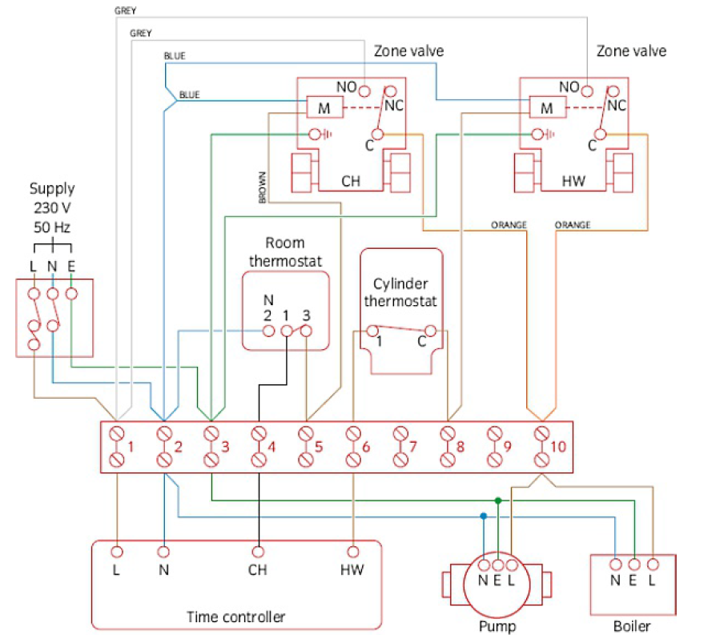
Interpret Drawings - Circuit Diagrams
Circuit diagrams contain information on how circuits and systems operate. They can be provided as detailed layouts, although some information
such as length of run may
be omitted for clarity.
In most instances, these
diagrams are used for
diagnostic purposes so
that designers, installers
and maintainers understand
how their actions may
influence a particular
component or arrangement.

Slide 7
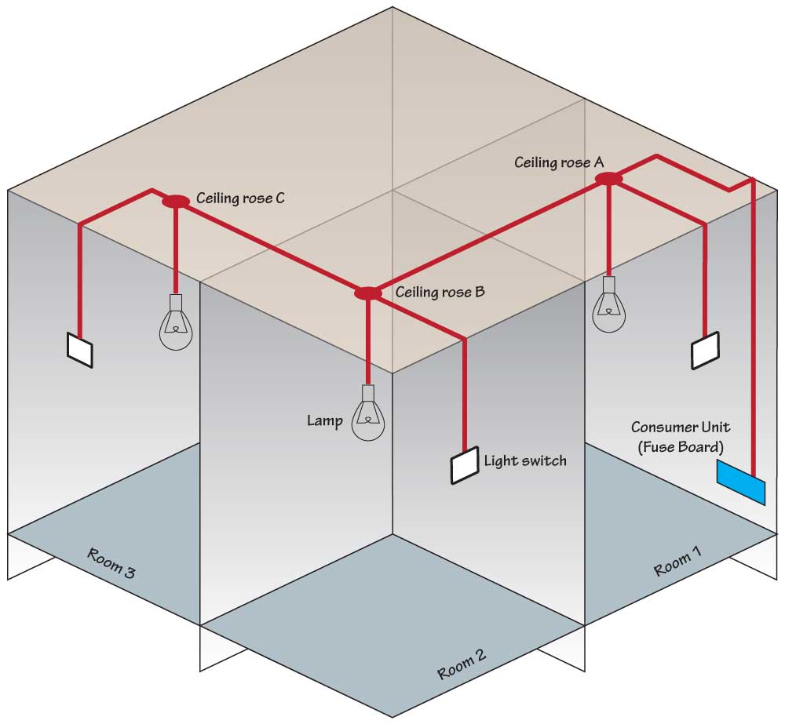
Lighting Circuit - Overview
A domestic lighting circuit looks complicated at first sight, but if you look at it as a
number of individual
lights each wired in
much the same way
it becomes a lot
simpler to understand.
The next two slides
look more closely at
The first and middle light fittings
The last light fitting
.

Slide 8
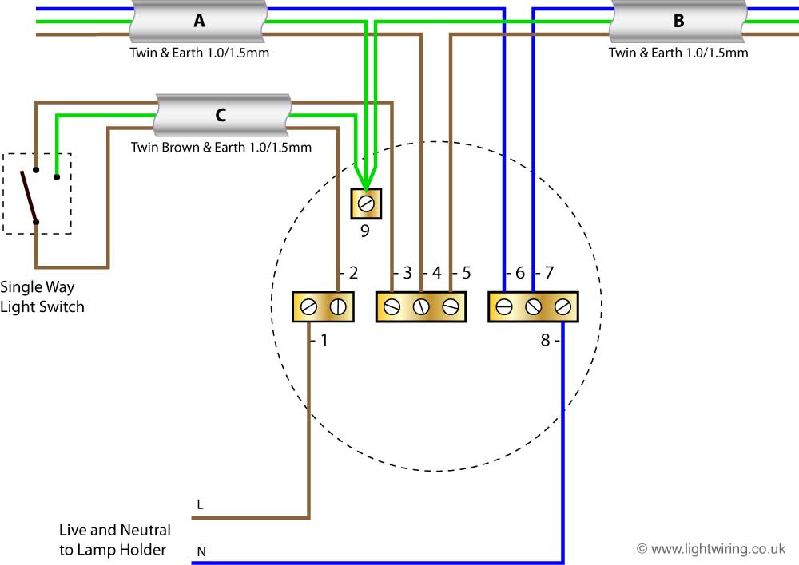
Lighting Circuit – First and middle lights
The first and middle light fittings have
A cable A from the previous light (or consumer unit) bringing in a live, neutral and an earth (cpc)
A cable B that feeds the
next light fitting with its
live, neutral and an earth
(cpc)
A cable C which takes a
live and cpc to the
switch and returns a
switched live back to
the light.
a 2 core flex taking a
switched live and neutral
to a lamp holder.

Slide 9
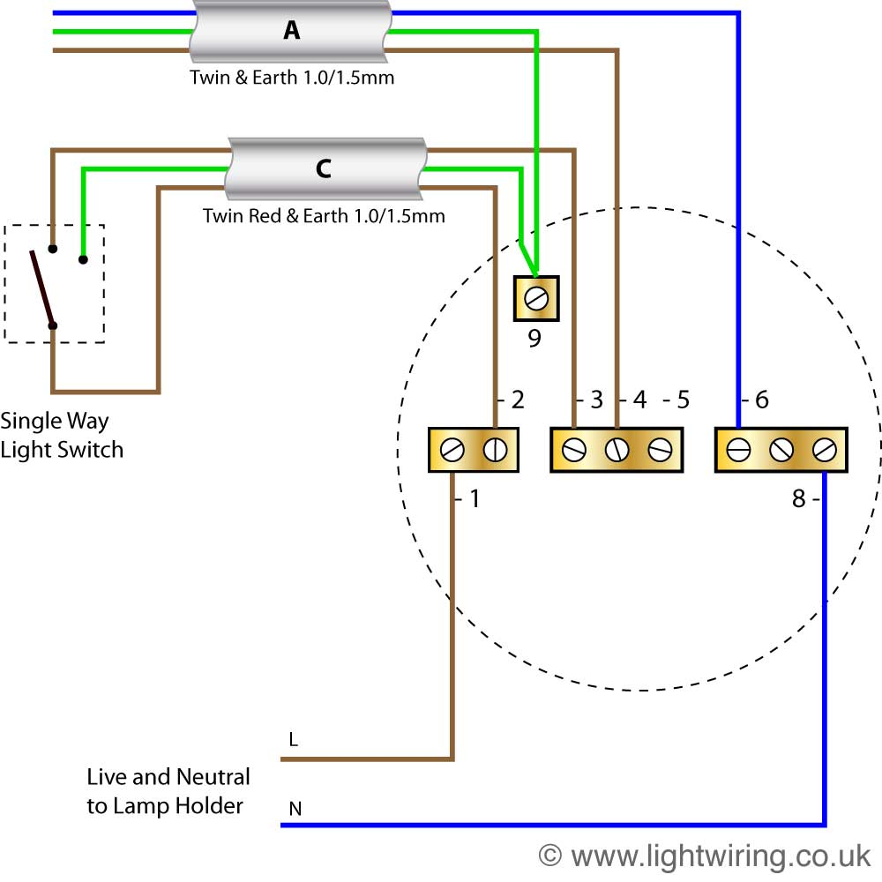
Lighting Circuit – Last light
The last light fitting has
A cable A from the previous light (or consumer unit) bringing in a live, neutral and an earth (cpc)
A cable C which takes a
live and cpc to the
switch and returns a
switched live back to
the light.
a 2 core flex taking a
switched live and neutral
to a lamp holder.

Slide 10
Other Diagram resources available on Canvas at
Other interactive circuit diagram resources available at
https://canvas.hull-college.ac.uk/robertEyre/

Slide 11
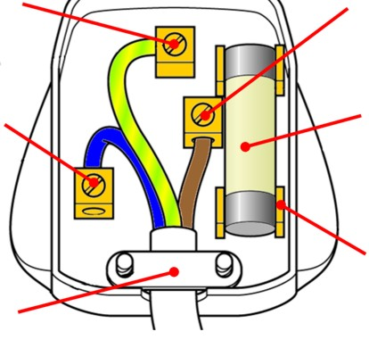
Wiring of 13A Plug Top
The 3 wires connect as follows
BR for BRown and Bottom Right for live
BL for BLue and Bottom Left for neutral
Earth goes in the top centre terminal.
No nicks in inner insulation
No stray strands outside terminals
Correct polarity connections
Outer sheath clearly clamped by cord grip
Conductors doubled over (if practical)
Earth conductor long enough to be last to be pulled out should cord grip fail/become loosened.

Slide 12
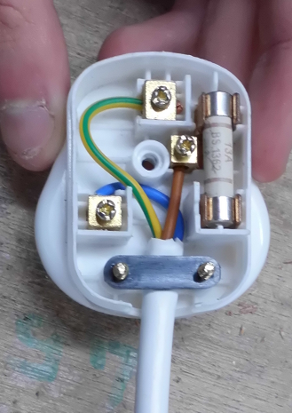
Wiring of 13A Plug Top – Student example
The 3 wires connect as follows
BR for BRown and Bottom Right for live
BL for BLue and Bottom Left for neutral
Earth goes in the top centre terminal.
No nicks in inner insulation
No stray strands outside terminals
Correct polarity connections
Outer sheath clearly clamped by cord grip
Conductors doubled over (if practical)
Earth conductor long enough to be last to be pulled out should cord grip fail/become loosened.

Slide 13
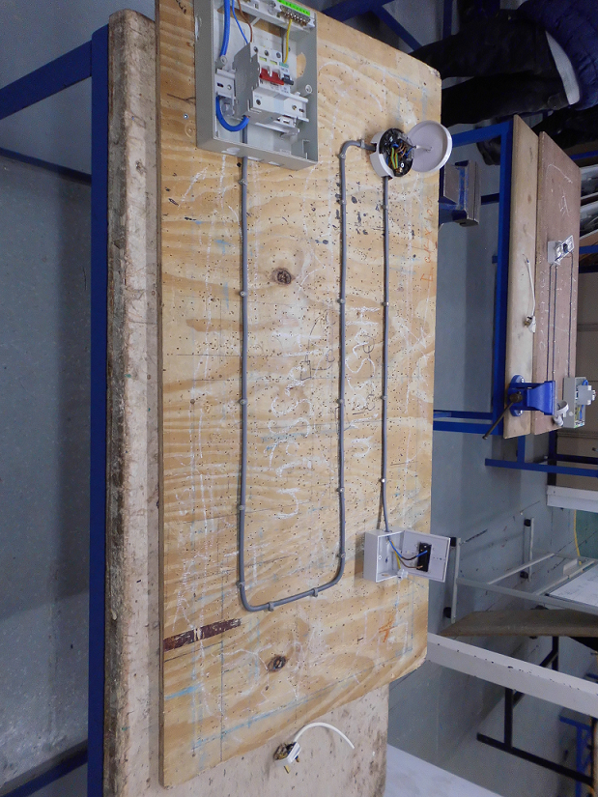
Lighting Circuit Task – Student example
Board Layout
Note the
layout
neatness of the clipping
the neatness of the bends.

Slide 14
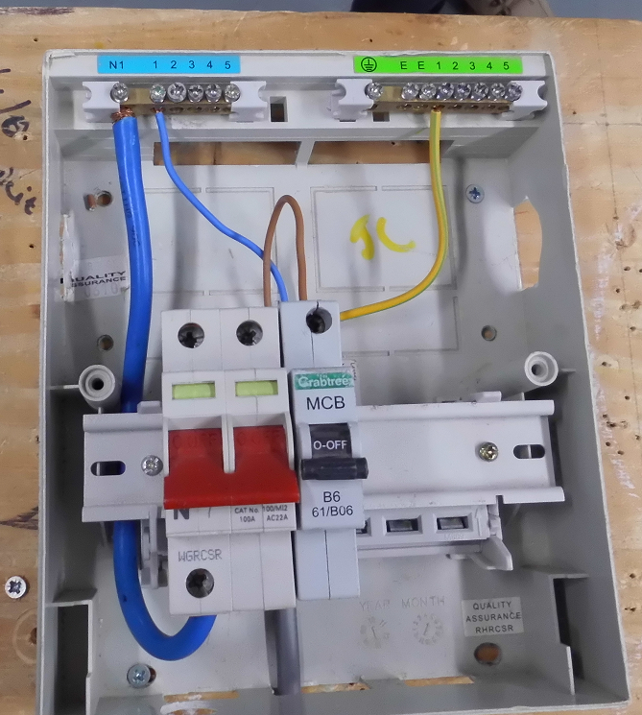
Lighting Circuit Task – Student example
Consumer Unit
Note the
Choice of 6A breaker for lights
Correct polarity connections
Using terminals 1 for circuit 1
Correct choice of cable.

Slide 15
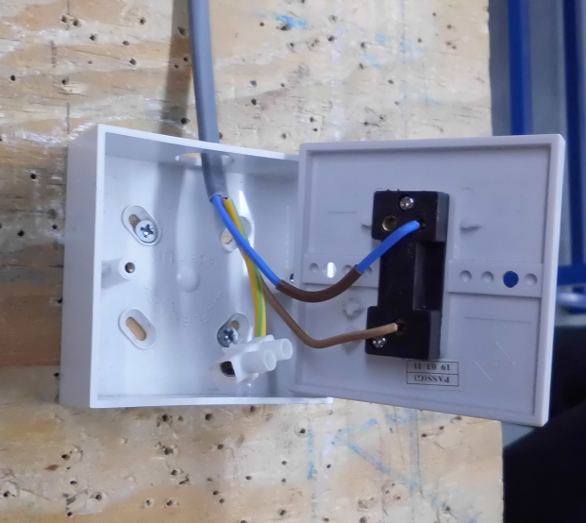
Lighting Circuit Task – Student example
Light Switch
Note the
Use of earth sleeving to cover
the bare cpc
Use of strip connector to park
the cpc
Correct connection in terminals.
Use of a small bit of brown
sleeving to indicate blue is now
being used as a switched live
Cable sheathing present inside the back box

Slide 16
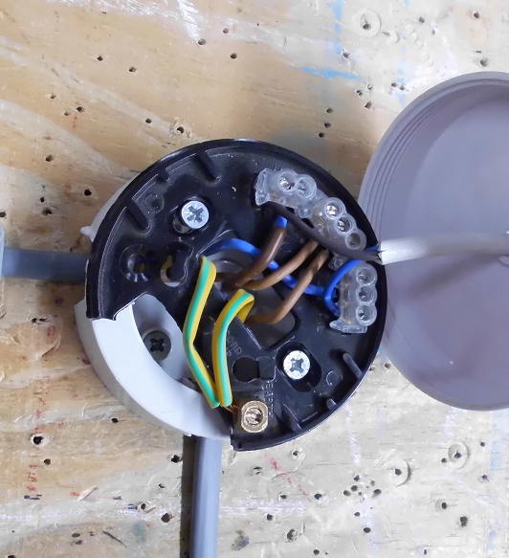
Lighting Circuit Task – Student example
Light Fitting
Note the
Use of earth sleeving to cover
the bare cpc
Correct connection in terminals.
Use of a small bit of brown
sleeving to indicate blue is now
being used as a switched live
Cable sheathing present inside
the back box

Slide 17
Safely testing
On completing a wiring task it is important to check that it has been wired correctly and is safe to use.
In order to do this we carry out tests with test instruments.
Before carrying out these tests in real life we need to make sure that circuits we are testing are “dead” as the tests would be dangerous to us and damage equipment if we carried them out on a live (energised) circuit.
NOTE Your lighting circuit will never be made live so will be safe for you to test.

Slide 18
Safely testing for continuity –Why?
One of the first tests we need to make is that the circuit the connections are sound all along the circuit.
By sound we mean that the cables are connected to the right terminals and that each connection is nice and tight to allow electricity (current) to flow easily.
Loose connections
  Make it more difficult for electricity to flow.
  Can create hot spots and potentially start fires.
  Can prevent appliances from working properly/as expected or lights to flicker.
  Can slow down fuses and breakers from clearing faults.

Slide 19
Safely testing for continuity –How?
We need to test from one end of a circuit to the other and make sure we get a very low resistance reading.
On your small lighting circuit on a wooden board this is quite easy to achieve as you can reach from one end to the other but in real life these ends of circuits could be 10s of meters away and on different floors.

Slide 20
Safely testing for continuity –How?
To test continuity we use a low resistance ohmmeter.
Before taking continuity tests we need to make sure our reading is not affected by the test instrument itself so we need to test the test instrument to ensure:
  it is not damaged in any way
  it is still within its calibration date
  the batteries are OK
  the leads and crocodile clips are undamaged
  the instrument functions properly.
NOTE Any test reading we take will include the resistance of the leads of the meter so we either zero the meter or deduct the reading we get when we test the meters lead reading from any test results.

Slide 21
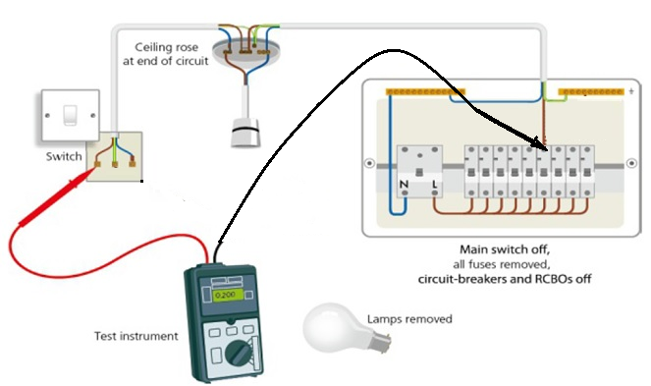
Safely testing for continuity –How?
On our small demo board we can take readings from end to end fairly easily. We need to check the continuity of live to live, neutral to neutral and earth to earth.
As the live and neutral
conductors are the same
size and length their
readings should be similar
(within 0.05Ω) of each
other.
As the earth(cpc) tends to be slightly smaller we would expect its continuity reading to be slightly higher than those of the live and neutral.

Slide 22
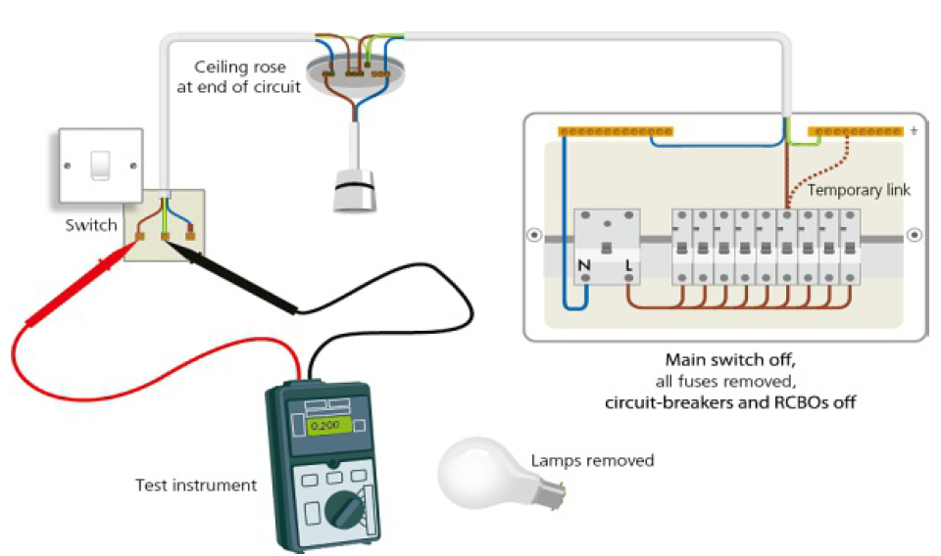
Safely testing for continuity –How?
In real circuits we can short one end out and test from the other to get readings of L,N and earth continuities.
If we short L&N out at
the board and take a
reading at the end point
the reading we would be
for both L & N continuity
readings.
As live and neutral are
similar and length half
the reading is the live
continuity and half the
neutral continuity*.
*Note don’t forget to deduct the meter lead resistance before dividing

Slide 23
Leaving the work area safe & tidy
On completing the practical tasks you need to have it assessed. ONLYAFTER your work has been assessed AND photo evidence has been taken can you complete the assessment by
leaving your work area clean and tidy
returning tools and equipment
return excess materials
dispose of any waste materials.

