Slide 1
Unit 106 Understand and demonstrate fundamental electrical installation operations
Outcome 6 Know how to carry out basic electrical practical applications
Bob Eyre

Slide 2
Objectives
6.1 identify typical drawings and specifications used for basic electrical circuits and cables
6.2 state the industry procedures for:
accurately measuring and recording the requirements for the practical application
wiring a 3 pin plug
assembling a simple one-way electrical lighting circuit with battery supply
inserting a simple switch mechanism into the completed wiring circuit
safely testing for continuity on a completed wiring circuit.

Slide 3
Theory Part of Your Practical Assessment
This outcome relates to the theory part of the practical assessment which takes place in the last few weeks of this module.
In it you will need to
demonstrate your understanding of theory you have been taught throughout the module
demonstrate your practical skills by carrying out a couple of electrical task.
Photographic evidence will be taken before you disassemble your work and tidy up.

Slide 4
Measurement /choice of materials
In order to be able to carry out tasks you need to be able to decide the tools and materials needed for a task.
You have 2 tasks for the practical element of this module. These are
  Safely wiring a 13A plug top.
  Assembling a simple 1 way lighting circuit.
For both of these tasks you should be able to select
  the appropriate tools to carry out the task safely
  the appropriate materials needed to complete the task safely and so that they work correctly

Slide 5
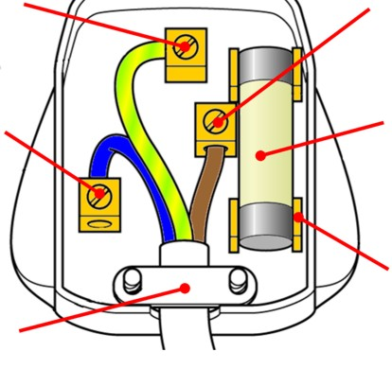
Wiring of 13A Plug Top
The 3 wires connect as follows
BR for BRown and Bottom Right for live
BL for BLue and Bottom Left for neutral
Earth goes in the top centre terminal.
No nicks in inner insulation
No stray strands outside terminals
Correct polarity connections
Outer sheath clearly clamped by cord grip
Conductors doubled over (if practical)
Earth conductor long enough to be last to be pulled out should cord grip fail/become loosened.

Slide 6
Assembling a 1 Way lighting circuit
This task involves wiring a pendant set light fitting from a consumer that is switched by a 1 way light switch
The students should
Clip cables neatly
Follow the spec
Create a circuit that works
Indicate conductor use by correct use of coloured sleevings
Make sound electrical connections

Slide 7
Safely testing
On completing a wiring task it is important to check that it has been wired correctly and is safe to use.
In order to do this we carry out tests with test instruments.
Before carrying out these tests in real life we need to make sure that circuits we are testing are “dead” as the tests would be dangerous to us and damage equipment if we carried them out on a live (energised) circuit.
NOTE Your lighting circuit will never be made live so will be safe for you to test.

Slide 8
Safely testing for continuity –Why?
One of the first tests we need to make is that the circuit the connections are sound all along the circuit.
By sound we mean that the cables are connected to the right terminals and that each connection is nice and tight to allow electricity (current) to flow easily.
Loose connections
  Make it more difficult for electricity to flow.
  Can create hot spots and potentially start fires.
  Can prevent appliances from working properly/as expected or lights to flicker.
  Can slow down fuses and breakers from clearing faults.

Slide 9
Safely testing for continuity –How?
We need to test from one end of a circuit to the other and make sure we get a very low resistance reading.
On your small lighting circuit on a wooden board this is quite easy to achieve as you can reach from one end to the other but in real life these ends of circuits could be 10s of meters away and on different floors.

Slide 10
Safely testing for continuity –How?
To test continuity we use a low resistance ohmmeter.
Before taking continuity tests we need to make sure our reading is not affected by the test instrument itself so we need to test the test instrument to ensure:
  it is not damaged in any way
  it is still within its calibration date
  the batteries are OK
  the leads and crocodile clips are undamaged
  the instrument functions properly.
NOTE Any test reading we take will include the resistance of the leads of the meter so we either zero the meter or deduct the reading we get when we test the meters lead reading from any test results.

Slide 11
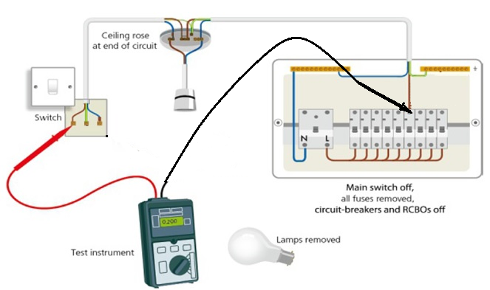
Safely testing for continuity –How?
On our small demo board we can take readings from end to end fairly easily. We need to check the continuity of live to live, neutral to neutral and earth to earth.
As the live and neutral
conductors are the same
size and length their
readings should be similar
(within 0.05Ω) of each
other.
As the earth(cpc) tends to be slightly smaller we would expect its continuity reading to be slightly higher than those of the live and neutral.

Slide 12
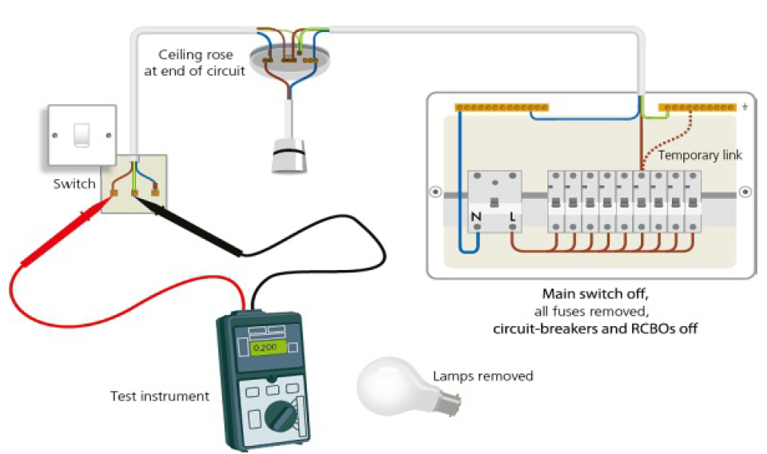
Safely testing for continuity –How?
In real circuits we can short one end out and test from the other to get readings of L,N and earth continuities.
If we short L&N out at
the board and take a
reading at the end point
the reading we would be
for both L & N continuity
readings.
As live and neutral are
similar and length half
the reading is the live
continuity and half the
neutral continuity*.
*Note don’t forget to deduct the meter lead resistance before dividing

