Slide 1
Unit 106 Understand and demonstrate fundamental electrical installation operations
Outcome 4 Know the types of basic electrical materials and components
Bob Eyre

Slide 2
Objectives
4.1 identify materials and components used for basic electrical practical applications:
cable and flex (ie, flat twin and earth)
conduit (plastic and steel)
earth sheathing
trunking
switched socket outlets (single and double with back boxes)
light switch plates (ie, single, integral or multiple)
consumer unit
circuit breakers and fuses (ie, MCB, RCB, RCD)
ceiling rose and lamp holders
plug tops
4.2 identify associated materials for electrical applications:
various fixings (ie, clips and cleats).

Slide 3
Cables and flexes
Electricity is directed through wires (cables and flexes) that come in a variety of sizes, types and number of cores. These vary according to where they are used and what they are supplying.
More power consuming circuits need bigger cables.
Lights don’t need much power so typically use 1mm or 1.5mm cable.
Sockets can use more so typically use 2.5mm or 4mm cable.
Showers use even more power so typically need 6mm or 10mm cable.
Some cables have built in mechanical protection, others don’t.
Some only need 3 conductors (live, neutral and earth) others need more conductors or cores.

Slide 4
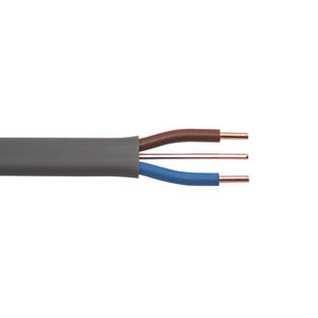
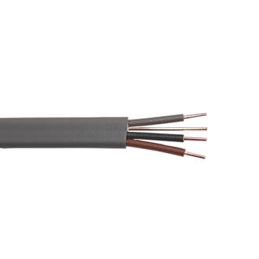
Cables and flexes – twin + cpc
Domestic installations where cables are run
under floors, clipped in lofts buried in walls
are usually wired in twin and earth (also known as twin and cpc*). These cables have separate cores that are insulated and an outer protective sheath.
Sometimes in more complex switching of lighting circuits we use 3 core and cpc.
*cpc means circuit protective conductor (another name for earth)

Slide 5
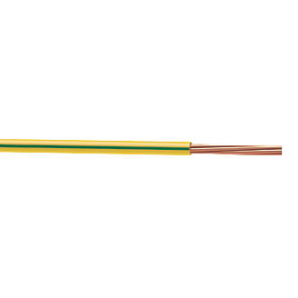
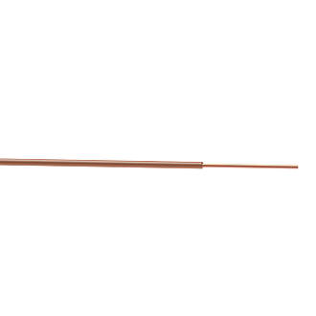
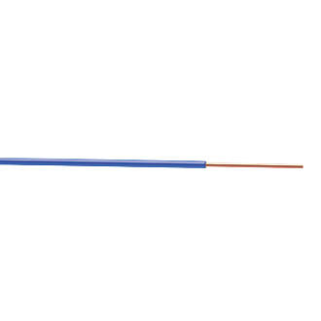
Cables and flexes - singles
Sometimes cables are installed in tubes called conduits where we don’t need the outer sheath due to the protection given by the conduit.
These singles tend to be stranded and flexible which allow them to be drawn into conduits.
They come in a variety of colours and sizes. They should only ever be used inside conduits or enclosures due to them not having a protective outer sheath. One exception is the earth (green/yellow striped version)

Slide 6
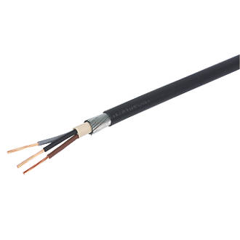
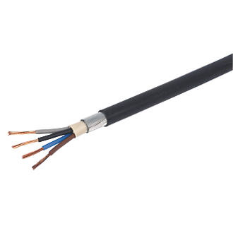
Cables and flexes - SWA
SWA or Steel Wire Armoured is mainly used in commercial and industrial installations and comes in a variety of sizes and numbers of cores.
It consists of individually insulated cores with a mix of core colours that are encased in a protective sheath.
These are then surrounded by a layer of metal wires that give mechanical protection to the inner cores.
This is all then covered by a outer plastic case which protects the inner metal protective layer against corrosion. SWA needs special glands to make off the ends/ connect to appliances/boxes.

Slide 7
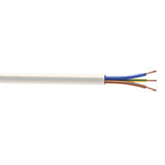
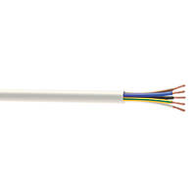
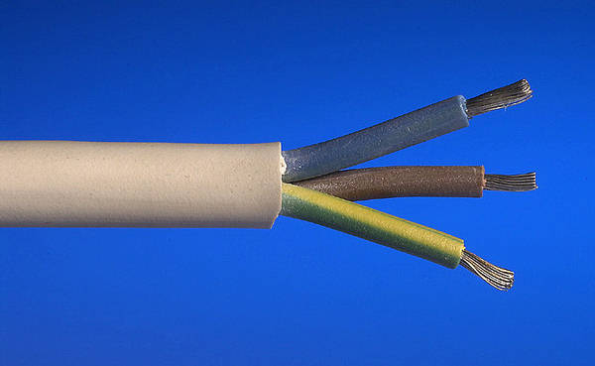
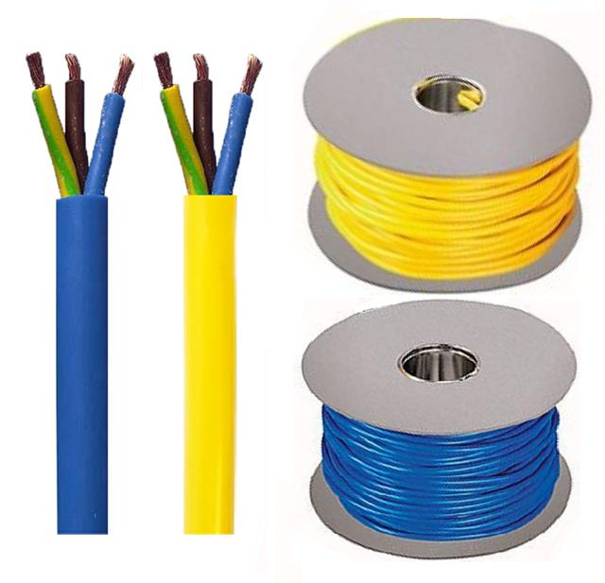
Cables and flexes - flexes
Flexes tend to be used for low level power uses to feed appliances or in control circuits and come in a variety of sizes and numbers of cores from
2 core used to connect lamp holders to ceiling roses
3 core flex to connect appliances to plugs
multi-core flexes for control circuits such as central heating.
Some such as butyl are more heat resistant and useful for connecting to heaters/immersion heaters
Others are harder wearing such as arctic and used in industry and is able to withstand wider temperature ranges and used outdoors. Yellow used for 110Vand blue for 230V

Slide 8
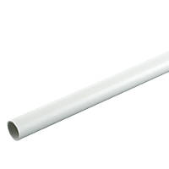
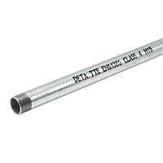
Conduit (plastic and steel)
Conduit is one of a number of containment systems of electrical wires. It is similar to pipe, comes in a variety of sizes in plastic and metal and provides mechanical protection to wires (usually singles). Most common sizes are 20mm and 25mm dia.
PVC conduit comes in either black or white and is used to provide a basic level of mechanical protection. It connects together by simply pushing into fittings such as adaptors or boxes.
Metal conduit comes in galvanised or black painted finishes and gives a greater level of mechanical protection. It needs to be threaded and screwed into its fitings such as adaptors or boxes.

Slide 9
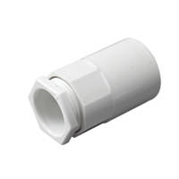
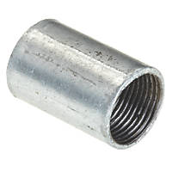
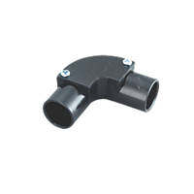
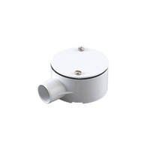
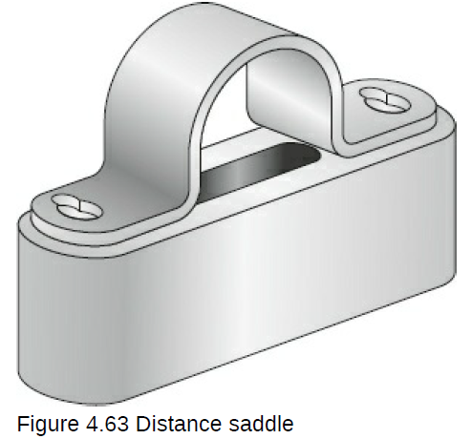
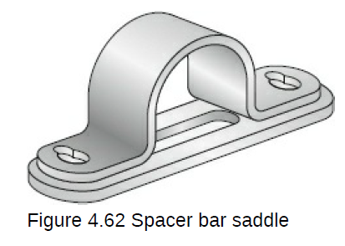
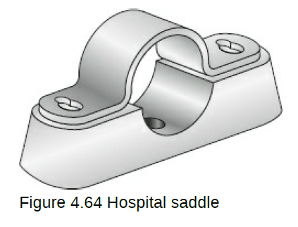
Conduit (plastic and steel)
Both types of conduit have similar fittings such as
adaptors, couplers, bends and boxes.
Both fasten to walls and ceiling using saddles which come in a variety of types that give different offsets from the wall that help cleaning

Slide 10
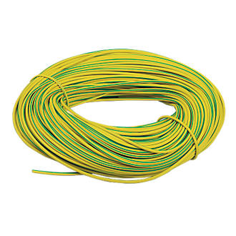
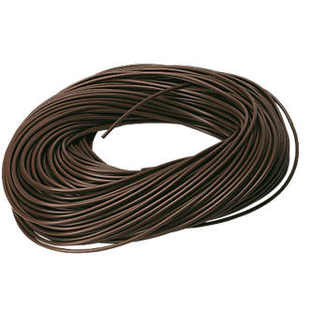
Earth Sheathing / sleeving
Sheathing/sleeving is like an empty wire or drinking straw and comes in a variety of sizes and colours.
The two most common types being
Earth or CPC sleeving which is green and yellow striped and is used to cover the bare middle core in twin and cpc cables.
Brown or live sleeving which is used to indicate a change of use of the blue core in twin and cpc cables when the cable is being used as a switch wire. A small piece (approx 1cm) is placed over the blue core at the switch and light fitting to show it is no longer a neutral.

Slide 11
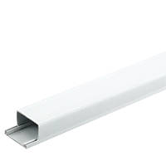
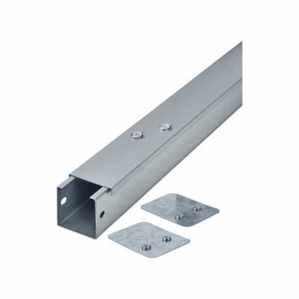
Trunking
Trunking is another form of containment systems of electrical wires. It is of a box shape with a lid, comes in a variety of sizes in plastic and metal and provides mechanical protection to wires
There are too many different size combinations to list here. PVC trunking tends to be used in offices whilst metal is more often used in commercial, industrial installations.
Both types have a variety of manufactured fittings available such as bends,
couplers, end caps etc

Slide 12
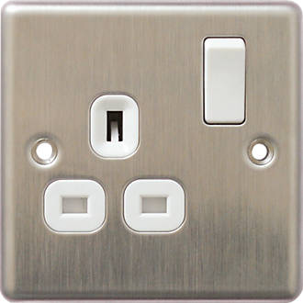
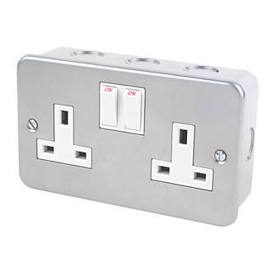
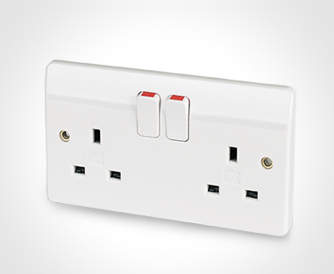
Socket Outlets
Socket outlets come in a variety of finishes from standard plain white, decorative metal finishes to more industrial metal-clad types used in industry when they need to be capable of withstanding the occasional accidental knock or two.
Sockets usually come in single or double varieties which are often referred to as 1 gang or 2 gang. They usually have a switch for each socket, which makes it safer as switching off the appliance before removing it is safer especially with heaters drawing more current.
Unswitched sockets are available for appliances such as fridges and freezers which you wouldn’t want switched off accidentally.

Slide 13
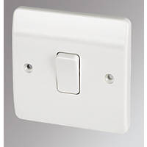
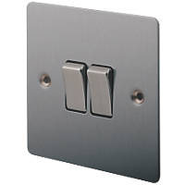
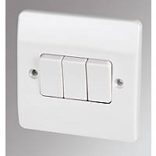
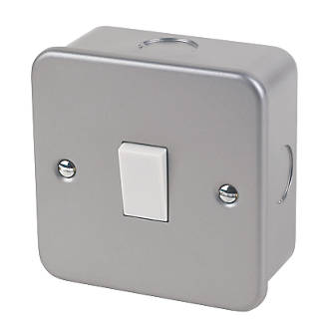
Light Switches
Like sockets, light switches come in a variety of finishes from standard plain white, decorative metal finishes to more industrial metal-clad types used in industry when they need to be capable of withstanding the occasional accidental knock or two.
Like sockets they also come in singles and multiple varieties which are often referred to as 1 gang, 2 gang 3 gang etc.

Slide 14
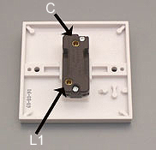
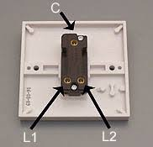
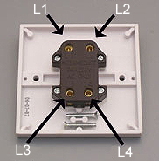
Light Switches
As well as having a “gang” to indicate the number of switches in a unit each switch can have another characteristic which is not obvious from the front. This is to allow different switching combinations.
The simplest is 1 way and is a straightforward on/off arrangement that you would have for a light turned on and off from just one position such as in a bedroom.
Next is 2way where the switch switches between connecting common (C) with L1 and L2. By pairing with another 2 way switch a light can be controlled from two locations such as a landing or corridor light.
Lastly is an intermediate switch which can be inserted between a working 2way system and allows a light to be controlled from more than two positions by it switching between parallel mode and crossover modes.

Slide 15
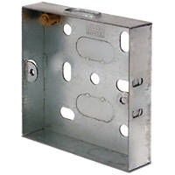
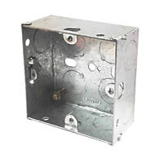
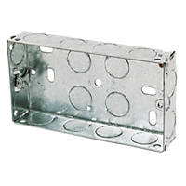
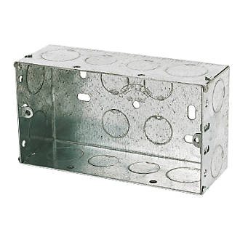
Back boxes – Switches & Sockets
Different circuits draw more current, which means larger wires which need more space for terminations into switches and sockets.
Back boxes are available in plastic and metal and different combos of gangs and depths to allow for these different circuit arrangements. Different situations have different minimum box depths such as
Standard light switches 16mm deep 25mm might be better for low profile or multi gang switches
Standard Sockets 25mm deep 35 might be better for low profile or sockets feeding a spur socket
Cooker Switch 47mm deep

Slide 16
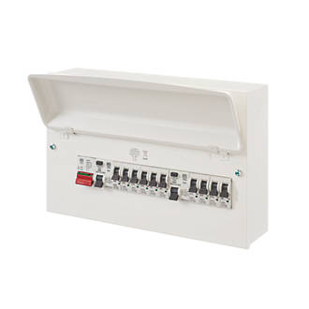
Consumer Unit
Generally, the first unit in an installation, where the supply is split into circuits, is called the Consumers’ Control Unit (CCU). This may sometimes be referred to as a distribution board or DB and sometimes simply as a consumer unit (CU). The CCU will have protective devices inside. They control and protect the circuits and could include:
miniature circuit breakers (MCB)
residual current devices (RCD)
residual current breakers with overload (RCBO)
fuses.

Slide 17
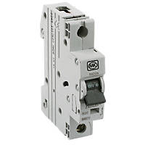
Circuit Breakers & Fuses - MCBs
MCBs or circuit breakers are thermomagnetic devices capable of making, carrying and interrupting currents under normal and abnormal conditions.
They come in a variety of current ratings for different circuits such as
6A
10A
16A
20A
32A
40A
45A and above

Slide 18
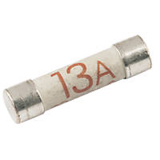
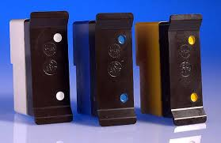
Circuit Breakers & Fuses - Fuses
Fuses have been a tried and tested method of circuit protection for many years. A fuse is a very basic protection device that is destroyed and breaks the circuit should the current exceed the rating of the fuse. Once the fuse has ‘blown’ (i.e. the element of the fuse has melted or ruptured), the fuse needs to be replaced.
They are available in a variety of types and current ratings.
cartridge fuses and rewireable (3036) domino types

Slide 19
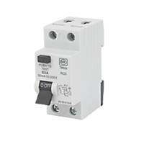
Circuit Breakers & Fuses - RCD
Residual current devices The basic principle of residual current devices (RCDs) is a simple balance arrangement. When the load is connected to the supply through the RCD, the live and neutral currents are equal in a healthy circuit.
When a fault develops to earth it is no longer balanced so operates or trips off disconnecting both live and neutral.
They are very sensitive tripping of at 30mA or 0.03A leaking to earth.
They do not trip off if a circuit has an overload fault just imbalances.

Slide 20
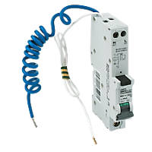
Circuit Breakers & Fuses - RCBO
Residual current breakers with overcurrent (RCBOs) combine the residual current function of RCDs and the overcurrent protection function typical of circuit breakers in a single device.
They are protect against current leakage to earth, overloads and short circuits.

Slide 21
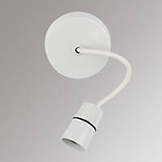
Ceiling Roses and lamp holders
The most common domestic light fitting is a pendant set which comprises 3 parts:
A Ceiling Rose – the uppermost part that fastens to the ceiling and contains incoming and outgoing supply cables and another connecting it to that lights switch
A short length of 2 core flex
A lamp holder usually (BC connection)

Slide 22
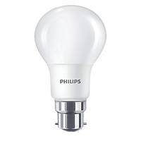
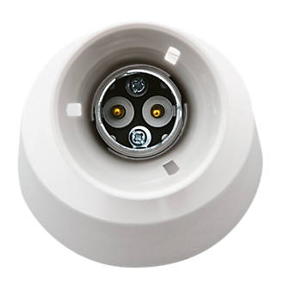
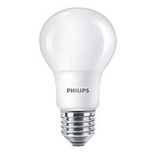
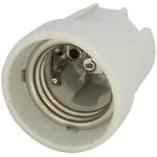
Lamp holders – types of connection
There are 2 main type of lamp holder BC and ES both of which have different size variants.
The more common is bayonet cap (BC) where the lamp has 2 connections on the base and the lamp is held in place in the holder by 2 earlike pins on the base of the lamp.
The other is Edison Screw (ES) where the lamp is threaded and connects to a central pin in the holder and the thread of the lamp touching the thread of the holder.

Slide 23
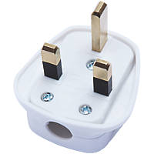
Plug Tops
Plugs come in a variety of sizes and shapes for different types of appliances. The most common domestic type being the 13A fused plug on household appliances.
Most people think they know how to wire a
13A plug properly but often they make a
poor job of it.

Slide 24

Plug Tops – properly wiring
The 3 wires connect as follows
BR for BRown and Bottom Right for live
BL for BLue and Bottom Left for neutral
Earth goes in the top centre terminal.
No nicks in inner insulation
No stray strands outside terminals
Correct polarity connections
Outer sheath clearly clamped by cord grip
Conductors doubled over (if practical)
Earth conductor long enough to be last to be pulled out should cord grip fail/become loosened.

Slide 25





Fixings
There are various methods of fixing electrical wires and fittings
Plugs and screws for basic fixing to walls
Saddles for fixing conduits to walls
Cable clips (twin and cpc)
Cable clips (circular flex)
Cable cleats (used on SWA)
Clips have an open side whilst cleats surround the cable and fasten with a screw that goes through both holes in the cleat

