Slide 1
Unit 106 Understand and demonstrate fundamental electrical installation operations
Outcome 3 Be able to use hand tools to carry out basic electrical tasks safely
Bob Eyre

Slide 2
Objectives
3.1 demonstrate the safe use of the following hand tools:
Pliers
Screwdriver (crosshead and electrical)
Wire stripper
Multi-meter
Tape measure
Level
3.2 demonstrate the care and maintenance required for the electrical hand tools listed in 3.1.

Slide 3
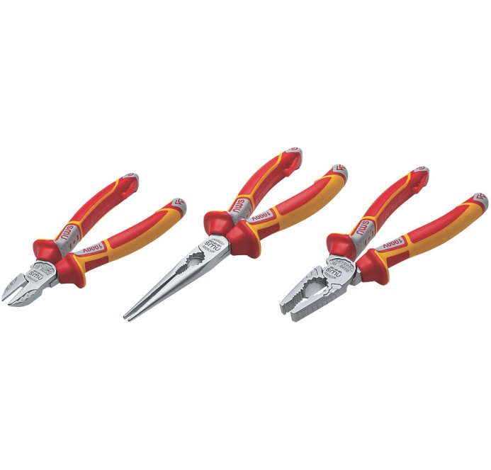
Safe Use of Hand Tools - Pliers
Pliers come in a variety of shapes and sizes,
each having their own purpose
Side cutters used for cutting cables to length, cutting sleeving tie wraps etc.
Long Nose pliers used for bending, cutting and gripping in more confined locations than standard pliers.
Pliers used for bending, cutting and gripping. Particularly useful in doubling over smaller conductors for a better/fuller fit in largish terminals.
They should ONLY be used on soft metals such as copper as cutting harder metals such as steel will damage them.
Electrical tools tend to be insulated. This does not mean you should work live

Slide 4
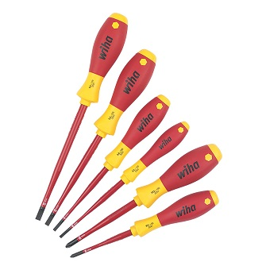

Safe Use of Hand Tools - Screwdrivers
Screws and screwdrivers come in a variety of types and sizes. Always use the correct size and type as:
Using too big a driver will either damage the terminal or not get a good enough fit to tighten the screw properly.
Using too small a screwdriver will mean the screwdriver is unable to tighten the screw properly and might lead to you snapping the head off the screwdriver.
Using the wrong type, such as a Pozi on a Phillips screw is likely to lead to slippage and damage to both screw and driver.

Slide 5
Safe Use of Hand Tools - Screwdrivers
Some manufacturers specify a given tightness or torque that terminals should be tightened to. Specialised torque drivers are available that help meet these requirements. In tightening terminals to these settings the connection is just right (neither too loose leading to potential overheating or too tight which can result in conductor damage and loose connection and overheating) which leads to a longer safer installation over its lifetime.
Electrical tools tend to be insulated.This does not mean you should work live

Slide 6
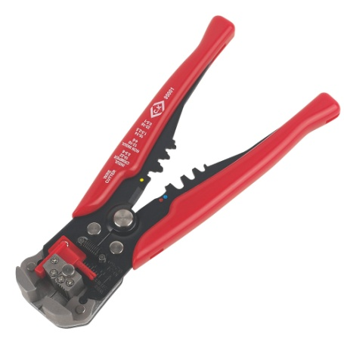
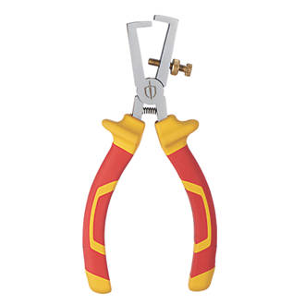
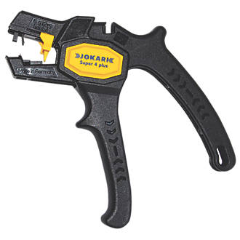
Safe Use of Hand Tools - Wirestrippers
Wire Strippers are better for removing insulation from conductors than side cutters or pliers as they reduce the chance of damage to the inner conducting core of the cable as they only cut into the outer insulation.
They come in a variety of styles. Some automatically adjust to cable size whilst others need adjustment for different sizes.
Care should be taken when using these tools to make sure they do not damage the conductors.

Slide 7
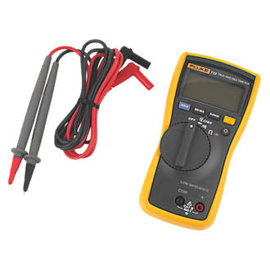
Safe Use of Hand Tools - Multimeters
Multimeters as the name suggests are capable of carrying out multiple different tests on electrical circuits such as voltage, current, resistance, diodes and capacitance etc.
In order to use this device safely the user MUST be confident in what they are doing and know that the circuit they are working on is DEAD, having first checked it with a voltage indicator, proving unit and safely isolated that circuit.
Having done so the user may use the meter to take “dead tests” such as resistance or component tests.
There have been a number of instances of accidents where multimeters have been used incorrectly to test for dead or accidently connected to a live supply on the wrong test setting.

Slide 8
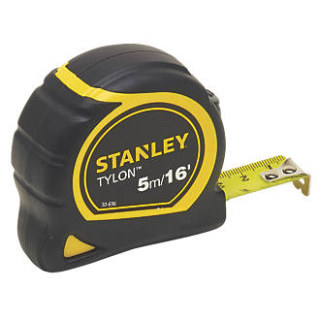
Safe Use of Hand Tools – Tape measures
Measuring tapes are used for measuring larger distances such as how much cable or conduit will be needed for a given task.
There are a few lesser known ways of using a tape measure
When taking internal measurements instead of trying to read the measurement where the tape bends place the tape into the corner and read the measurement and add on the tapes width (this should be written into the tapes base)
Forgotten your pen when marking where to cut? Why not use the serrated edge to make a mark where to cut.
Fed up of the tape zipping shut when near full extension? The end of the tape has a slot in the hook bit that is designed to slide over screw or nail heads. See if hooking it over a screw or nail helps.
Measure twice cut once.
Finally don’t let the tapes blade zip back in one go.

Slide 9
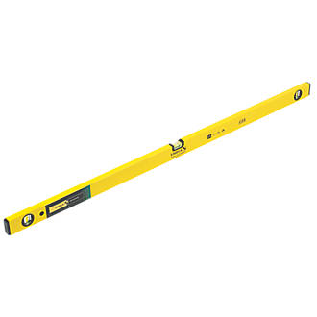
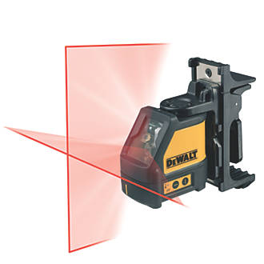
Safe Use of Hand Tools – Levels
Levels range from small ones that will fit inside a cupboard to longer ones with long straight edges to more modern laser levels.
Old fashioned bubble levels should be stored carefully to prevent damage or build up of dirt on their straight edges and damage to their bubbles. Damage could affect the accuracy.
In order to check accuracy on finding a surface is level by checking the bubble is between the markers. Mark where you measured, rotate the level by 180 degrees and check again. Get the bubble in the same position? Good your level is working OK.
Laser Levels can self level and be accurate over quite long distances but care should be taken that the laser will not shine in anyone's eyes.

Slide 10
Care and Maintenance
Looking after tools extends their useful life and helps prevent damage and injury.
Pliers
Don’t misuse them by trying to cut too hard a material or use as a hammer.
Check for damage to insulation.
Avoid excessive heat or moisture.
Keep free movement by occasional WD40
Screwdrivers
Use the correct combination of size and type for the screw.
Use the driver in line with the screw not at an angle to it.
Don’t use as a lever, chisel or punch.
Check for damage to insulation.
Avoid excessive heat or moisture.
Keep flat blades level

Slide 11
Care and Maintenance
Wire stripper
Don’t misuse them by trying to strip larger cables than it was designed for.
Check for damage to tool
Keep checking that cables being stripped are not having the conductor damaged during stripping.
Keep free movement by occasional WD40
Multimeter
Have it calibrated to make sure it continues to read accurately
Don’t use to prove circuits dead Use a voltage indicator and proving unit.
Replace batteries regularly
Turn off after use to preserve batteries
Keep in protective case to prevent damage from moisture, dust etc.
Keep within specified temperature range
Follow manufacturers instructions

Slide 12
Care and Maintenance
Tape measure
Don’t let it snap back it could loosen the end clasp resulting in the tape eating the whole blade or injure someone.
Don’t leave it extended after use as its more likely to get caught, dropped or damaged resulting in a buckled tape that won’t return properly.
Keep dry to prevent of rusting of retraction mechanism.
Make sure that on retracting the blade it doesn’t drag foreign bodies such as grit into it that could damage the retraction mechanism.
Avoid dropping it
Level
Store in a clean dry environment to prevent damage to the edges and bubble.
Clean edges before storing.
Remember damage to either the bubble or edge will result in readings being out.

